Slide 1
Y11 Apps Chapter 4 Situation 1
$500 is invested in an account for which the interest is paid at 10% per annum simple interest.
This means that each year, 10% of $500 is added to the account as interest.
After 1 year the account will be worth: $500 + 10% of $500
= 500 + 50
= $550
After 2 years the account will be worth: $500 + 2 x 10% of $500
= 500 + 2 x 50
= $600
Had the money been invested using compound interest, the interest would be added to the account at the end of each compounding period. This interest then itself earns interest in any following compounding periods and so on.
Earning ‘interest on the interest’ is the difference between compound and simple interest.

Slide 2

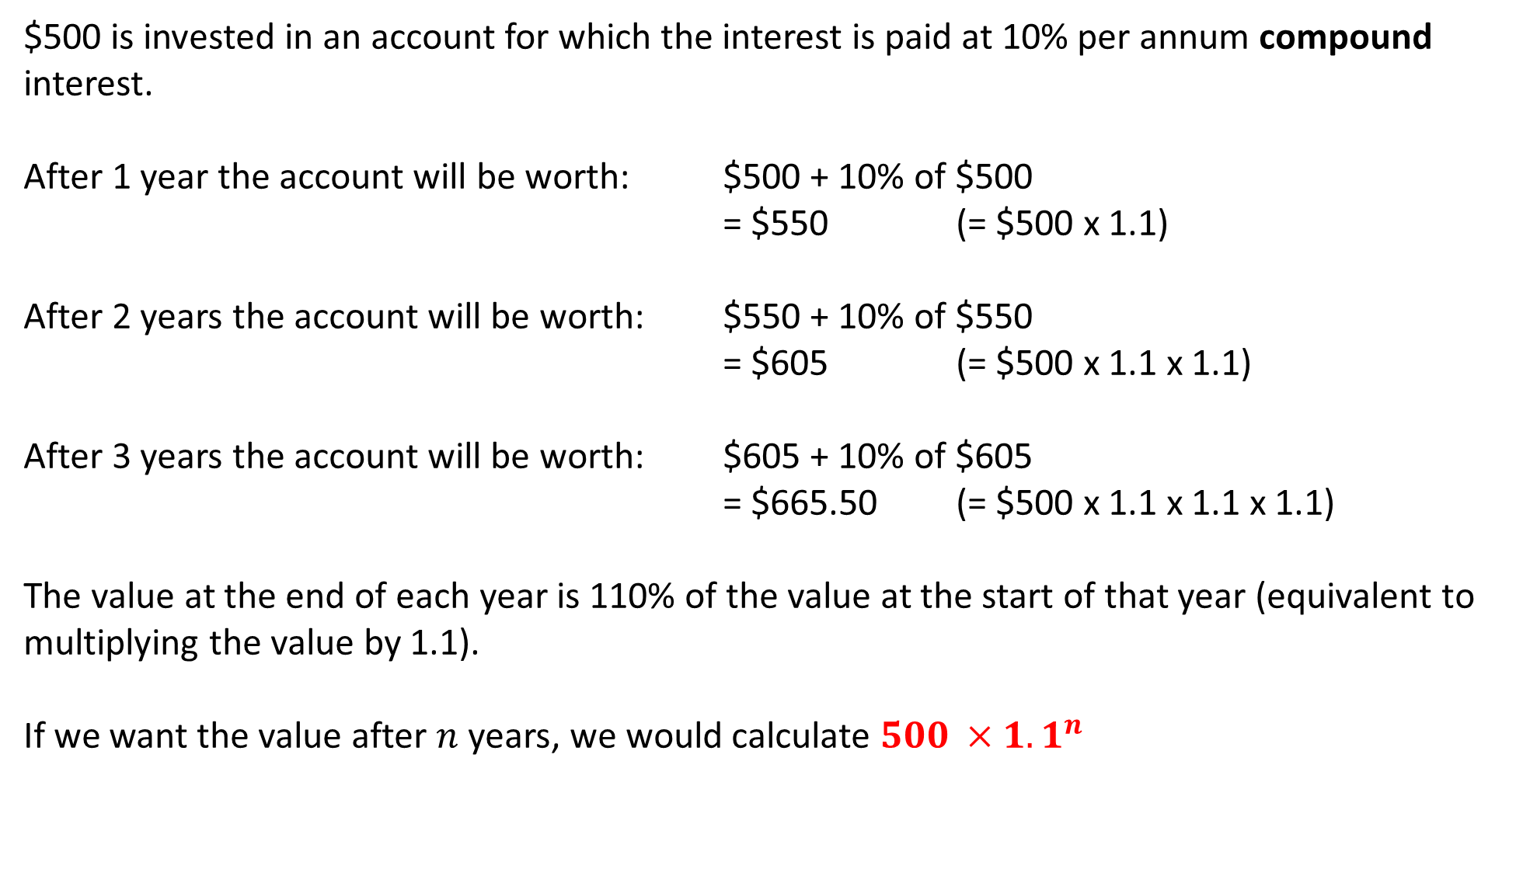

Y11 Apps Chapter 4 Situation 1
$500 is invested in an account for which the interest is paid at 10% per annum compound interest.
After 1 year the account will be worth: $500 + 10% of $500
= $550 (= $500 x 1.1)
After 2 years the account will be worth: $550 + 10% of $550
= $605 (= $500 x 1.1 x 1.1)
After 3 years the account will be worth: $605 + 10% of $605
= $665.50 (= $500 x 1.1 x 1.1 x 1.1)
The value at the end of each year is 110% of the value at the start of that year (equivalent to multiplying the value by 1.1).
If we want the value after $n$ years, we would calculate $500 ×{1.1}^{n}$
$$500×{1.1}^{2}$$
$$500×{1.1}^{3}$$

Slide 3
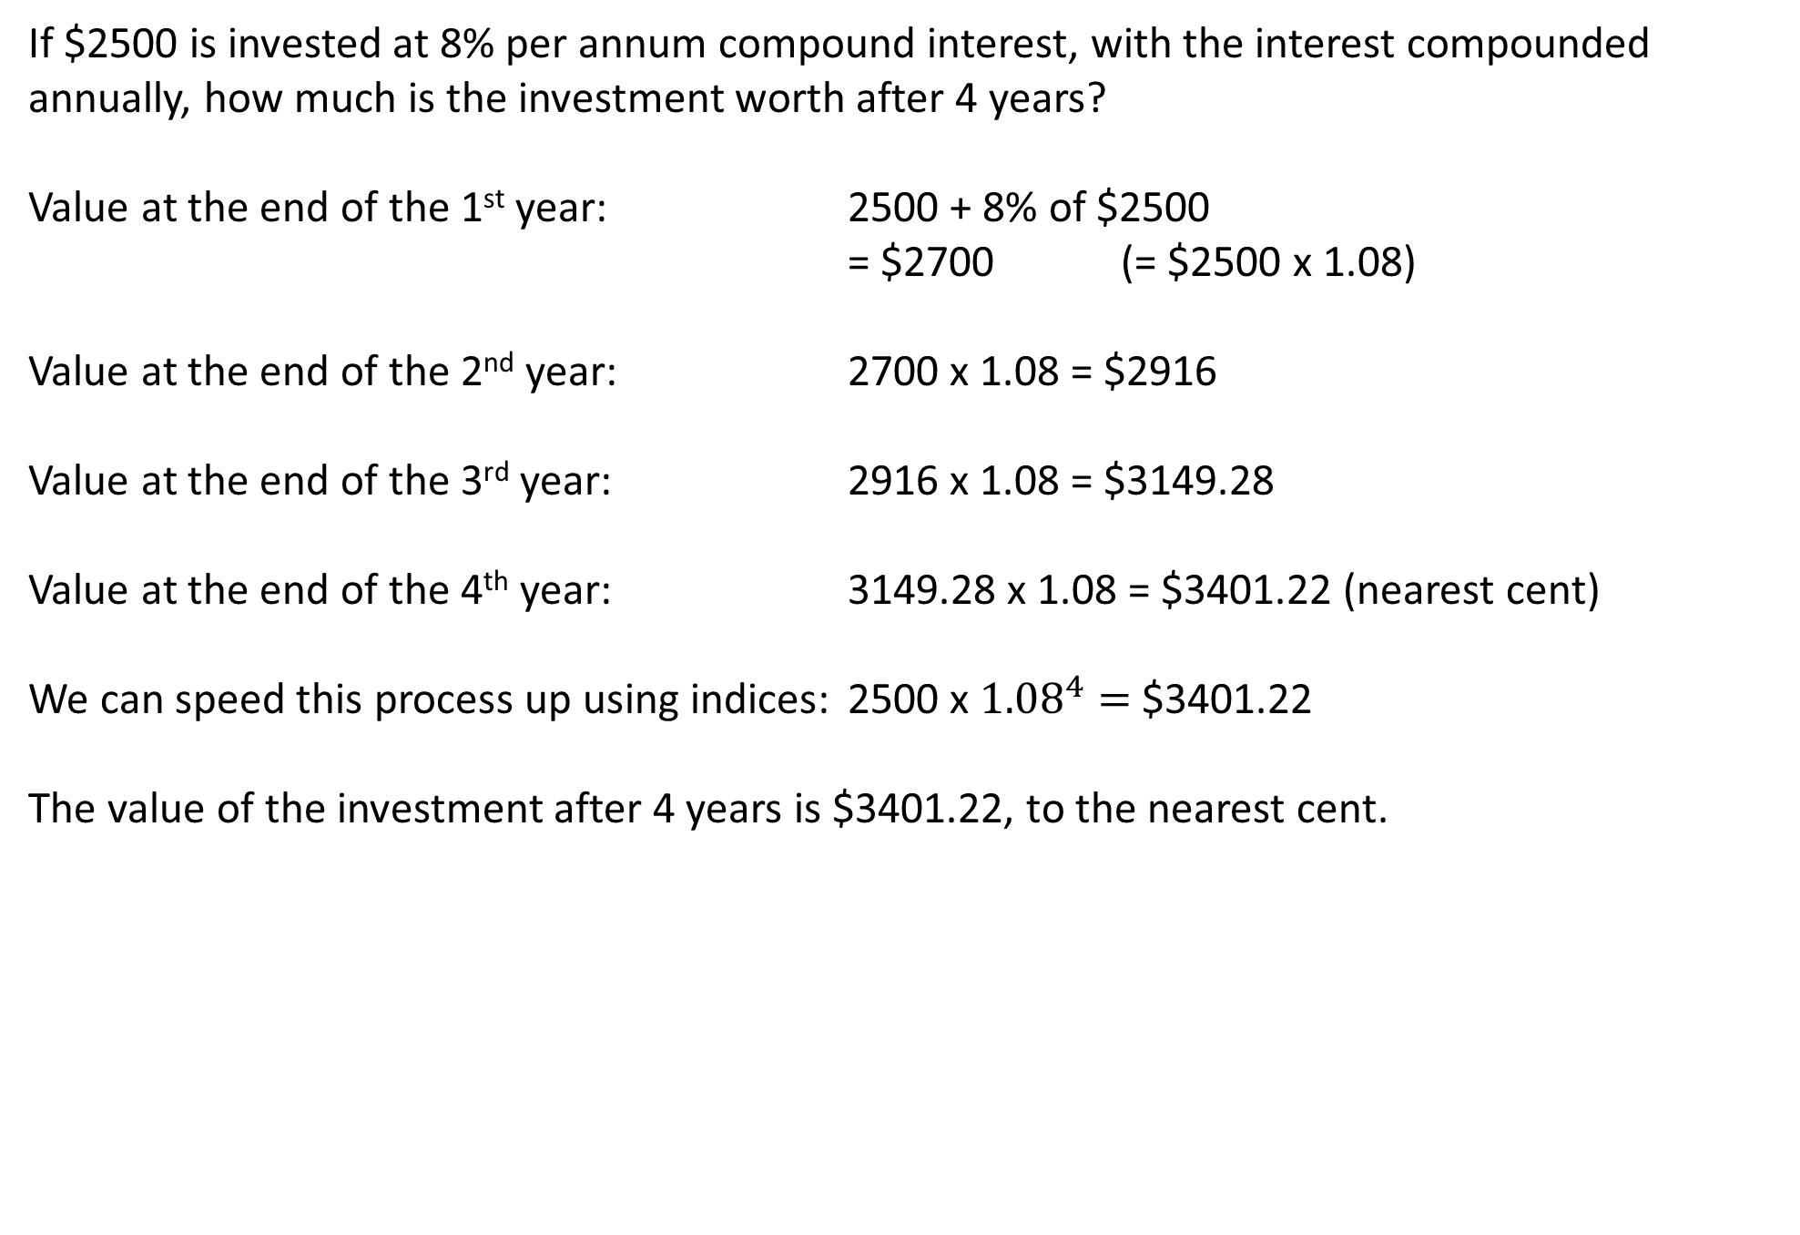
Y11 Apps Chapter 4 Example 1
If $2500 is invested at 8% per annum compound interest, with the interest compounded annually, how much is the investment worth after 4 years?
Value at the end of the 1st year: 2500 + 8% of $2500
= $2700 (= $2500 x 1.08)
Value at the end of the 2nd year: 2700 x 1.08 = $2916
Value at the end of the 3rd year: 2916 x 1.08 = $3149.28
Value at the end of the 4th year: 3149.28 x 1.08 = $3401.22 (nearest cent)
We can speed this process up using indices: 2500 x ${1.08}^{4}=$$3401.22
The value of the investment after 4 years is $3401.22, to the nearest cent.

Slide 4
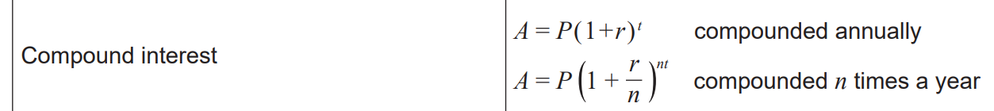

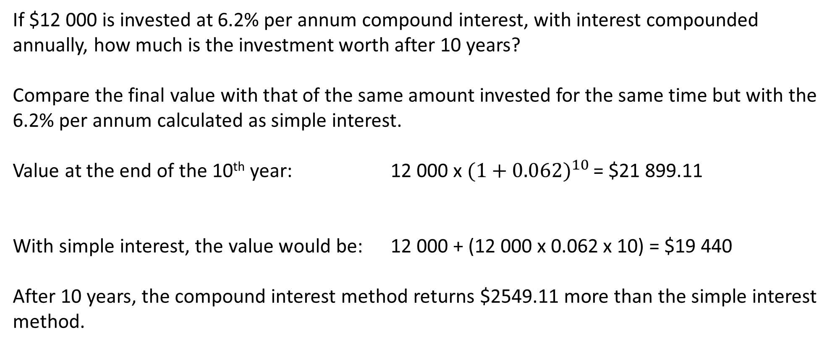
Y11 Apps Chapter 4 Example 2
If $12 000 is invested at 6.2% per annum compound interest, with interest compounded annually, how much is the investment worth after 10 years?
Compare the final value with that of the same amount invested for the same time but with the 6.2% per annum calculated as simple interest.
Value at the end of the 10th year: 12 000 x ${(1+0.062)}^{10 }$= $21 899.11
With simple interest, the value would be: 12 000 + (12 000 x 0.062 x 10) = $19 440
After 10 years, the compound interest method returns $2549.11 more than the simple interest method.

Slide 5
Y11 Apps Chapter 4 Example 3
Determine the interest paid on $5000 invested at 8% per annum compound interest for 3 years, with the interest compounded:
annually b) every 6 months c) quarterly
Value of investment after 3 years: $5000 × (1 + 0.08)^{3}=\$6298.56$
Therefore the interest paid: $6298.56 −5000=\$1298.56$
b) Value of investment after 3 years: $5000 × (1 + \frac{0.08}{2})^{6}=\$6326.60$
Therefore the interest paid: $6326.60 −5000=\$1326.60$
c) Value of investment after 3 years: $5000 × (1 + \frac{0.08}{4})^{12}=\$6341.21$
Therefore the interest paid: $6341.21 −5000=\$1341.21$

Slide 6
Y11 Apps Chapter 4 Example 4
Now do Exercise 4A Q1-8
How much will be owed after 3 years on a loan of $4000 with compound interest charged at 8% per annum, compounded daily?
In 3 years, there will be 3 x 365 or 1095 compounding periods.
Value of investment after 3 years: $4000 × (1 + \frac{0.08}{365})^{1095}=\$5084.86$
The total amount owed after 3 years would be $5084.86.

Slide 7
Y11 Apps Chapter 4 Situation 2
Inflation and depreciation are not examples of compound interest; however, they both involve repeated multiplication by a number.
For example, an inflation rate of 10% per annum is the same as repeated multiplication by 1.1 and a depreciation rate of 10% per annum is the same as repeated multiplication by 0.9.
A couple bought a house in 2006 for $310 000 and come to sell it 15 years later in 2021.
Due to inflation (the general rise in prices over time), the value of their house has increased by 3.4% each year.
Value of house after 15 years: $310 000 × (1 + 0.034)^{15}=\$512 000$(nearest $1000)
Not everything increases in value. Some items lose value as they get older (depreciation). For example, the value of a new car falls as the car gets older (until it gets so old it becomes rare or collectible in which case the value rises again).

Slide 8
Y11 Apps Chapter 4 Example 5
A particular item has a current value of $8600, this value rising in line with inflation.
With a constant annual inflation rate of 4.2%, what will the value of this item be:
a) 2 years from now? b) 25 years from now?
a) Value after 2 years: $8600 (1 + 0.042)^{2}=\$9337.57$(nearest cent)
b) Value after 25 years: $8600 (1 + 0.042)^{25}=\$24 054.23$(nearest cent)

Slide 9
Y11 Apps Chapter 4 Example 6
Now do Exercise 4B
A particular car has a new value of $28 000.
With a constant annual depreciation rate of 7%, what will the value of the car be:
a) 2 years from now? b) 8 years from now?
a) Value after 2 years: $28 000 (1 − 0.07)^{2}=\$24 217.20$(nearest cent)
b) Value after 8 years: $28 000 (1 −0.07)^{8}=\$15 668.29$(nearest cent)

